Slide 1
New Media and Empowerment
Dr. Nancy Dai
Department of Media and Communication

Slide 2
What We Will Learn Today
Understand the changing media landscape and the difference between traditional and new journalism
Examine different types of journalistic blogs, their specific characteristics, and principles of citizen journalism
Discuss the different viewpoints with regard to the role of new media in citizen empowerment
Understand the concept of digital divide and its relationship with empowerment

Slide 3
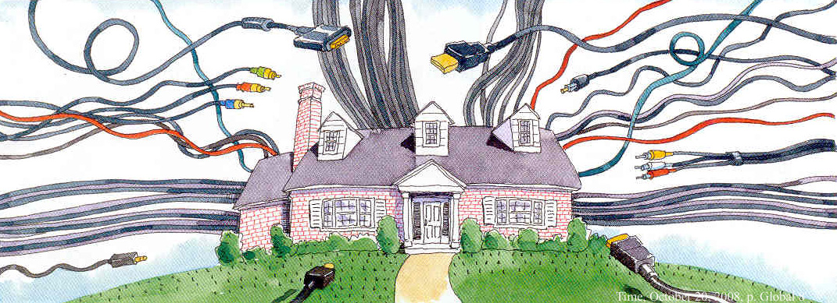
The Changing Media Landscape

Slide 4
Changing Media Landscape
Commercialization（商業化）: content
Market force drives media content production
Data-driven content production (big data)
Many people now use aggregated（聚集的） news apps to consume news, which means click rates will drive editorial decisions
From a user’s perspective, it also prevents people from being exposed to a variety of information, including information that challenges their existing beliefs and assumptions

Slide 5
Changing Media Landscape
Concentration: ownership（所有權）
A few media conglomerates（集團） dominate the market
E.g., 21st Century Fox merged with Disney
Affects media integrity（誠信/完整）, neutrality, diversity
Media integrity refers to the ability of a media outlet to serve the public interest and democratic process, making it resilient to institutional corruption within the media system, economy of influence, conflicting dependence and political clientelism.
Especially endangered in the case when there are clientelist（客戶） relations between the owners of the media and political centers of power

Slide 6
Changing Media Landscape
Globalization: scope
Nationalism
The production, distribution and consumption of an increasing number of media products now take place in a transnational context. Culturally, does it undermine nationalization?
Common ethical（道德） principles for journalists
Journalists should be able to agree on common ethical principles.

Slide 7
Changing Media Landscape
Proliferation: channel
Decentralized consumption
A result of natural market competition and commercialization.
More difficult for one media outlet to attract people’s attention.
Digitalization: delivery
Viral videos
Permanently recorded
The changing media landscape opens up a new space for a new form of content unfiltered（未經過濾的） through professional gatekeepers（把關人）.

Slide 8
Changing Media Landscape
Deregulation/Increased regulation: control
Major impact on the media landscape
In some parts of the world, media deregulation limits government control over media companies.
Caused dramatic（巨大的） political and economic changes in the U.S. media industry since the 1980s, while also inspiring intense（激烈的） ideological（意識形態） debate.
In other parts of the world, we saw increasing media regulation from the government

Slide 9
Properties and Values of Media
Old Media
New Media
News as finished product
Lecture, authoritative
Passive consumers
Trust in experts
Corporate
Closed
（獨家/唯一）Exclusive
Centralized
（精英專業人士）Elite professionals
（機構的聲音）Institutional voice
Heavily filtered
Platform dependent
News as a process
Conversation, participation
Empowered users
Trust in peers
Democratic, collaborative（民主的協作的）
Transparent
Shared
Distributed
Grassroots, peer-focused
Personal voice
Lightly filtered/Difficult to filter
Cross-platform

Slide 10
Many private media accounts (e.g., weblogs) openly challenge institutional or professional journalism by offering either competing or complementary（補充性的） information [and commentary（評論文章）] about news and current affairs.
Domingo & Heinonen (2008)

Slide 11
What is blogging?
A sort of diary, popular since 1999 when blogger.com was launched by Pyra labs
Usually maintained by an individual with regular entries (chronologically ordered按時間順序排列) of commentary, descriptions of events, or other material
Micro-blog: smaller in both actual and aggregate（匯總） file size, allowing exchanging small elements in a faster manner

Slide 12


What is blogging?
Interactive format, allowing visitors to leave comments and even message each other via widgets
Text, hypertext（超文本）, images, and links (to other webpages and to video, audio and other files)
Blogging sites offer users choices
of templates（模板）, easy and fast registration
Free hosting and free domain

Slide 13
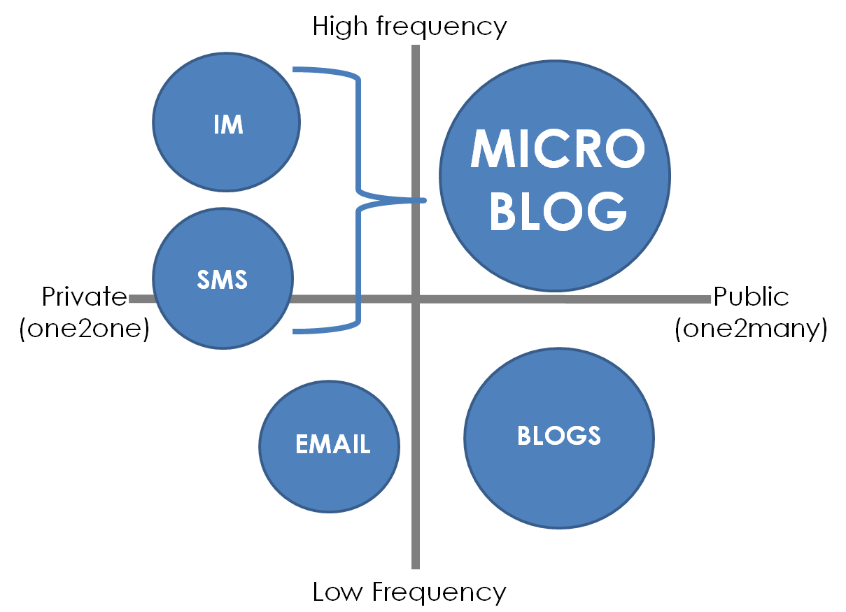

Slide 14
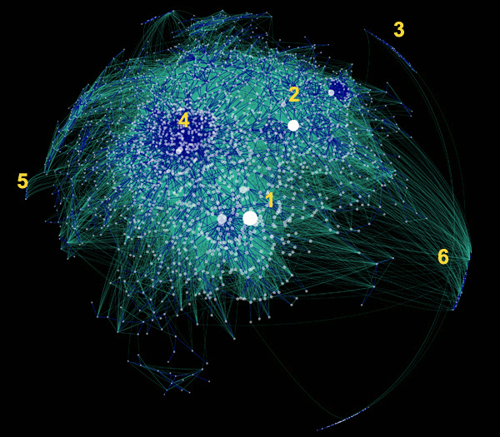
Active and Interconnected Blogosphere
A plot of the most active and interconnected parts of the blogosphere By Matthew Hurst (2011)

Slide 15

Weblog: A Form of Empowerment
Publishing Online:
From Web Log to We blog

Slide 16
Why do people blog?
To share expertise（專業知識） and experiences with others
To become more involved with my passion areas
To meet and connect with like-minded（志同道合的） people
To gain professional recognition
70%
58%
50%
42%
Source: Technorati Media (2011)

Slide 17
Why do people use Twitter?
Self-expression and networking
Boredom（無聊） relief through entertainment
Professional advancement
Escape through companionships (e.g., forget about worries and personal problems)
Source: Kim and Cha (2017)

Slide 18
Is blogging journalism?
Technically the answer is NO
 | Blogging | Journalism
Standard unit | Post | Story
Strengths | - Hyperlink（超鏈接）, low-cost - Convey diversified voices | - Professional support - Standardizing, homogenizing（同質化）

Slide 19
Is blogging journalism?
Mainstream journalists‘ antagonism（對抗性） towards bloggers sustained by the huge stress they find themselves under, which stems from five developments:
1. The collapsing（倒塌的） economic model of newspapers.
2. Journalists having to face new kinds of competition.
3. A shift in power to the audience. （權力向觀眾轉移）
4. New patterns of information flow in which information moves horizontally from citizen to citizen as efficiently as vertically.
5. Erosion侵蝕 of trust and related loss of authority.

Slide 20
Is blogging journalism?
But, bloggers can exercise journalism and be incorporated into journalistic practices
但是，博主可以行使新闻权，并被纳入新闻实践中
“What‘s really important is that people telling us about the world understand the importance of accuracy, verification（核查）, and transparency. How you voice your opinion is really a stylistic（作風） question.”
-- Jay Rosen
Professor of Journalism, New York University

Slide 21
Typology of Journalistic Weblogs
1. Citizen Blog: outside media companies
2. Audience Blog: platform provided by media
3. Journalist Blog: by journalists outside media
4. Media Blog: content by professional journalists
With a clear intention to collect, analyze, interpret or comment on current events to wider audience
有明确的收集、分析、解释或评论当前事件的意图，以使更多的人了解。
- These blogs perform the very same social function usually associated with institutional media.

Slide 22
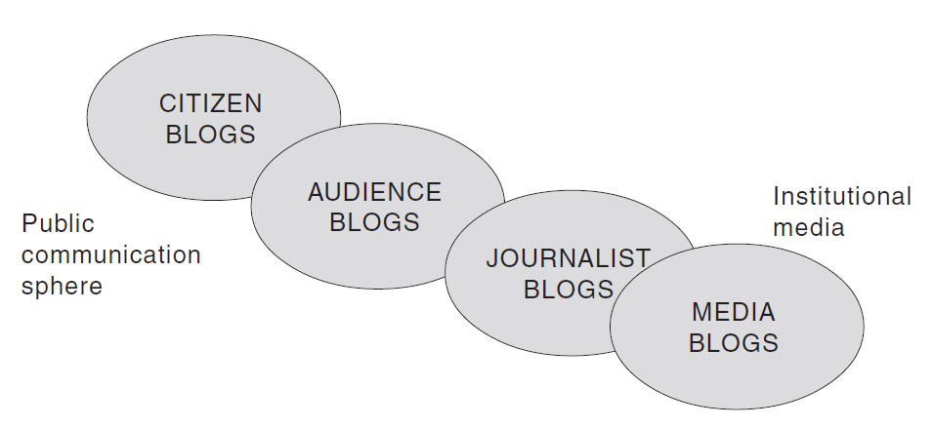
Typology of Journalistic Weblogs
These types of blogs differ not only in the type of content, but also in the way that content is delivered or written, such as by genre（流派）, by blogger, by media type and by device.

Slide 23
1. Citizen Blog
Written by the public outside the media
First-hand reporting and media commentary（評論文章） (watchblogs)
Content creator: ranging from amateur reporters to non-profit organizations
Functions:
Fact-checking: testing the truth of claims（主張） made by media
Highlight under-covered stories, biases（偏見）, and poor arguments

Slide 24


Fact-checking
Media Bias/Fact Check (MBFC News): Independent websites set up for correcting media bias

Slide 25



Fact-checking
Official report revealed by mainstream media: 11 people dead, 45 people on broad
Survivor & Eyewitness : at least 97 students, 60 confirmed death

Slide 26
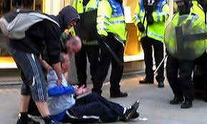
Fact-checking
Paul Lewis: How citizen journalism empowers the people and enables journalists to get closer to the truth
https://www.youtube.com/watch?v=9APO9_yNbcg

Slide 27
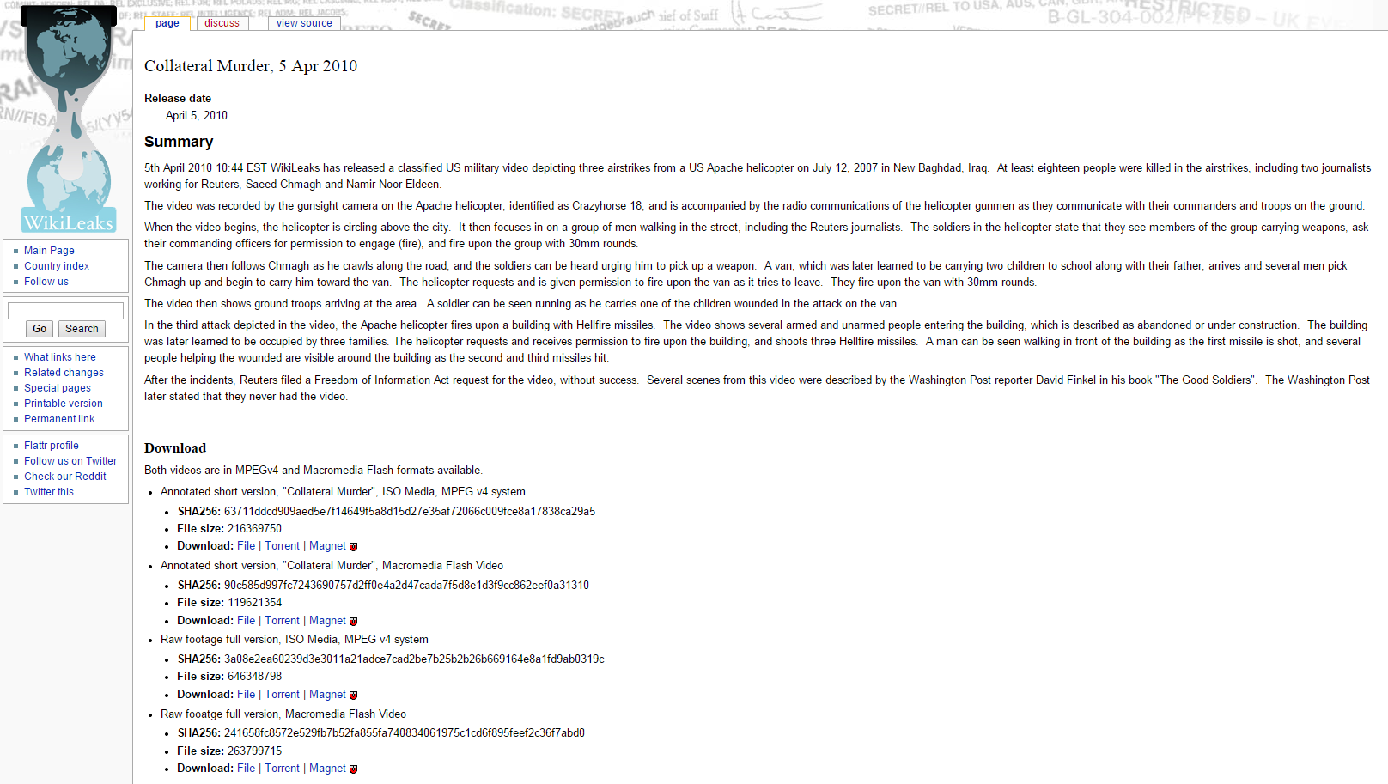
Highlight the uncovered: In April 2010, WikiLeaks activist exposed the secret ‘Collateral Murder（附帶謀殺？）’ video to the world, revealing how a US aircraft shot and killed Iraqi civilians（伊拉克平民） in July 2007.

Slide 28
2. Audience Blog
Written by the public within the media
Content creator: Audience/readers of the media
Aims
Promote a sense of community among audience
Foster（培養） dialogues between journalists and audience
Improve brand loyalty（忠誠度） and trust (similar to audience discussion forum)
（类似于观众讨论区）

Slide 29
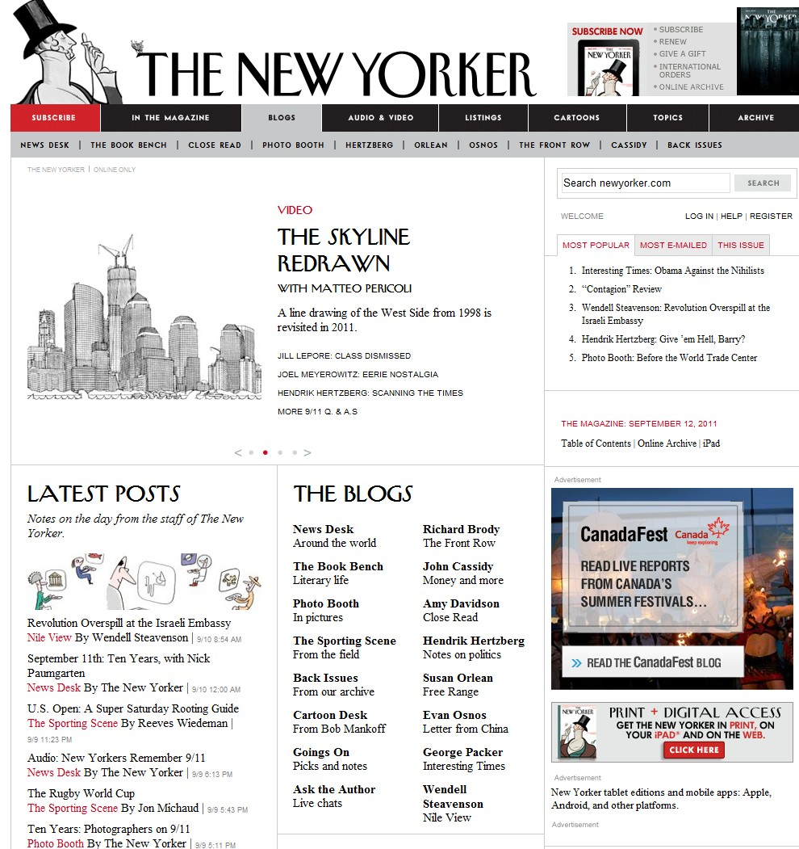

Slide 30
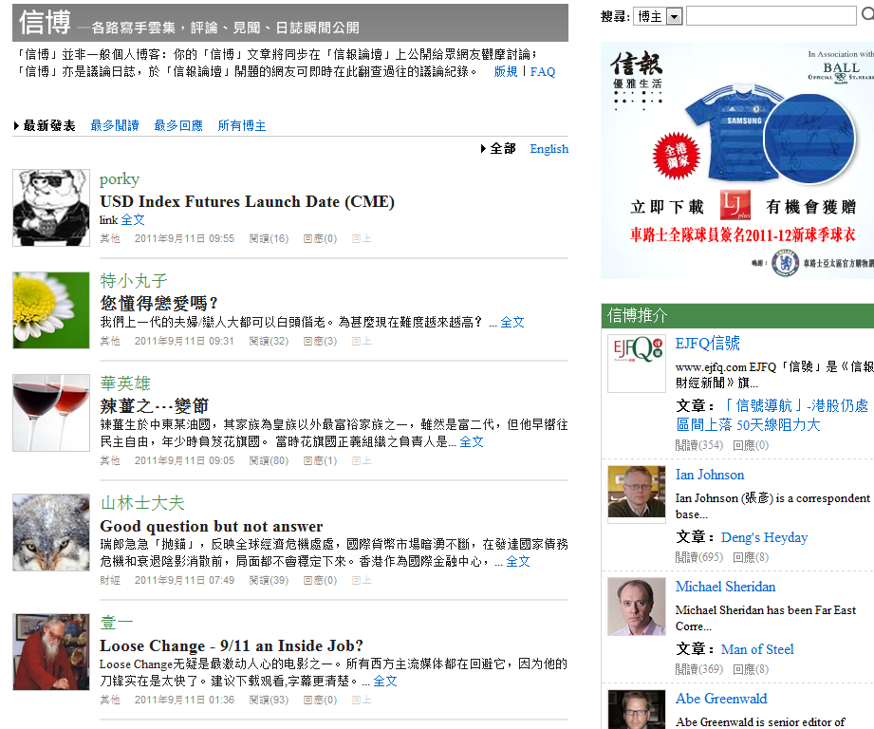
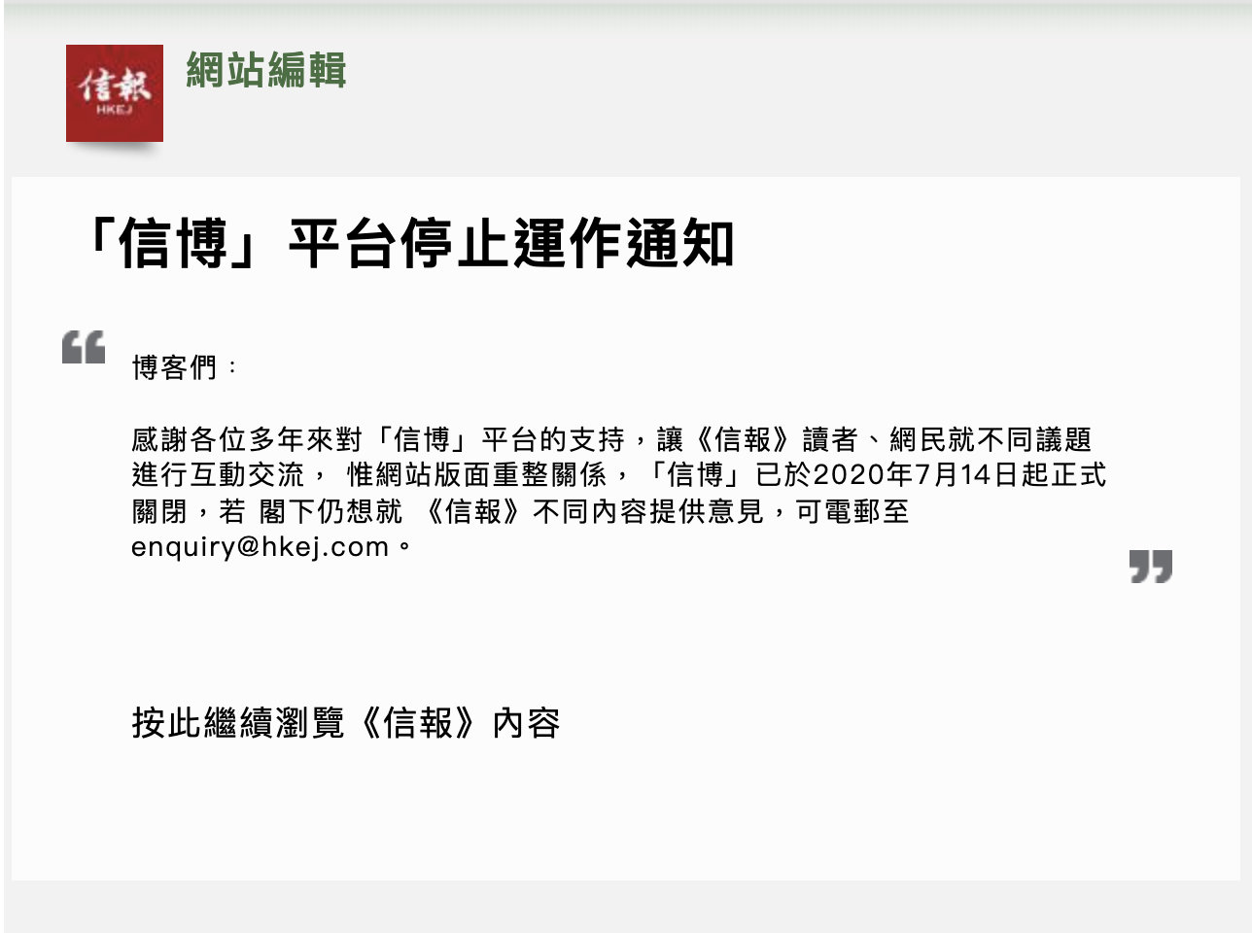


Slide 31
3. Journalist Blog
Written by journalists without professional affiliations（隸屬關係）
Features
Bring journalists closer in the blogosphere as they interact frequently through linking, commenting and citing each other（相互引用）
In-depth writing: not constrained（受限） by space and time
Less influenced by censorship or editorial board
Usually adopt an interpretative（解釋） tone and reflect certain opinion orientations（取向）

Slide 32
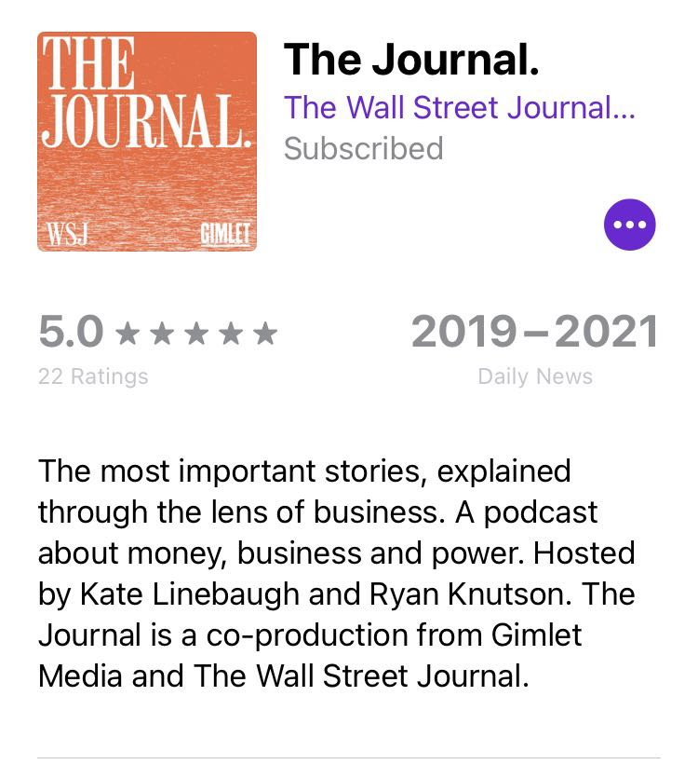
Journalist Blog
Podcast series run by the Wall Street Journal
Featuring background stories of the news stories they report, narrated
by its own journalists

Slide 33
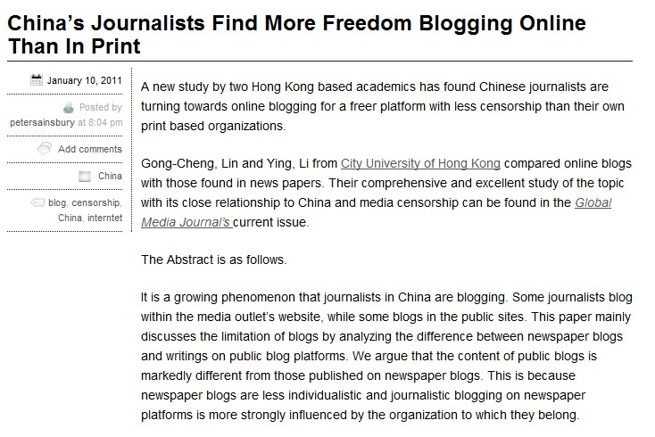
Journalist Blogging in China: The Development of Journalistic Professionalism

Slide 34
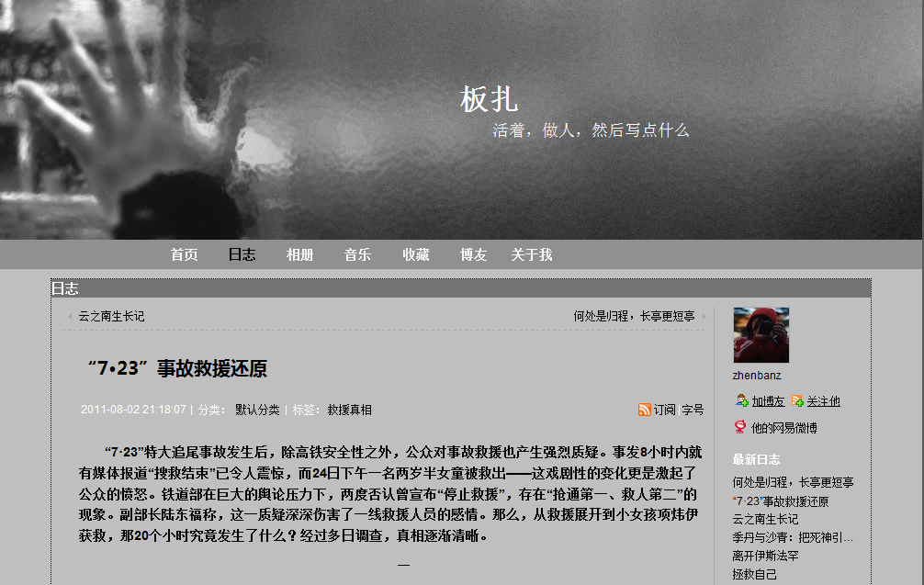
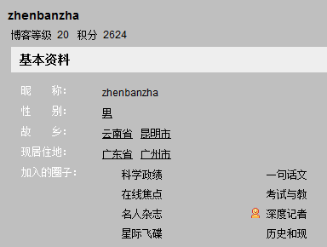
Journalist Blog

Slide 35
4. Media Blog
A new genre of journalism by media institutions媒体机构的新新闻流派
Two different approaches:
For special event coverage
对于特殊事件的报道
Opinion columns and commentary
观点专栏和评论

Slide 36
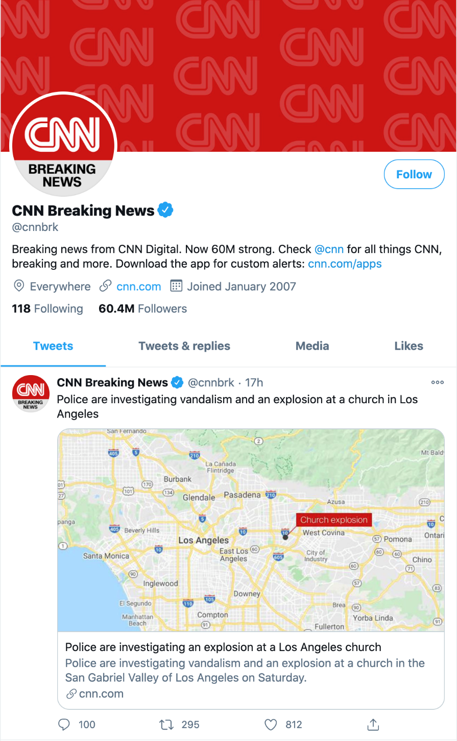
Special Event Coverage
Exploit the immediacy and the ease of publication of new media
利用新媒体的即时性和发布的便利性
Not for in-depth discussion purpose
不用于深入讨论的目的

Slide 37
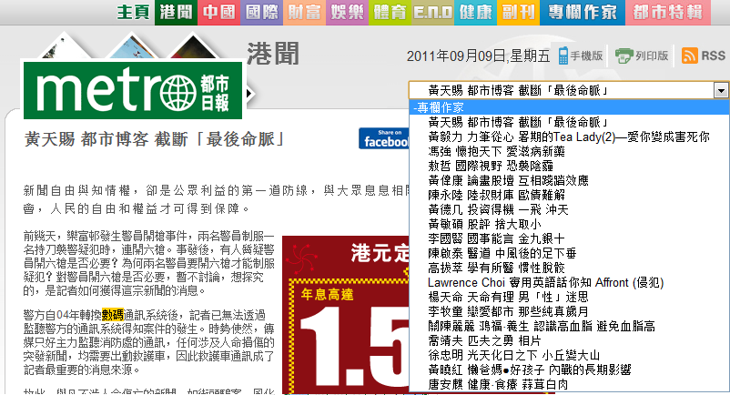
Opinion Columns & Commentary

Slide 38
AI Generated News: Challenge to human journalists?
News articles generated purely by AI
https://www.youtube.com/watch?v=6OiBS6pNDHA&t=28s&ab_channel=MONOK
Machine-assisted news article writing
An AI-assisted article from The Guardian Ausatralia
https://www.theguardian.com/australia-news/2019/feb/01/political-donations-plunge-to-167m-down-from-average-25m-a-year
AI news anchors
https://www.youtube.com/watch?v=bmqd9nYH5Fw&ab_channel=FoxBusiness
New forms of journalism practices that incorporate assistance from machines not only bring new challenges to journalists but also to the audience.

Slide 39
Principles of Citizen Journalism
Five basic principles for citizen journalism:
Accuracy
Check all the facts. Make sure that things are interpreted within the context and that the understanding is comprehensive.
Thoroughness徹底性
Go extra yard for information. There is no room for speculation in solid reporting.
在可靠的報道中沒有猜測的餘地。
Transparency
Reveal motives, background, and financial interests in writing about a subject.揭示写某一主题的动机、背景和经济利益
Link to source material as much as possible.
Gillmor & Lasica (2007)

Slide 40
Principles of Citizen Journalism
Five basic principles for citizen journalism (Con’t):
Fairness
Treating opposing point of views with respect.
Listening to different viewpoints and incorporating them into the journalism.
Letting people respond when they believe you are wrong, even if you do not agree.
Independence
Follow the story where it leads.
Gillmor & Lasica (2007)

Slide 41
New media = Empowerment?

Slide 42
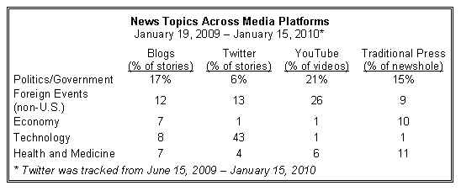
Empowerment: An Optimistic View
1. Challenge institutional journalism（對機構新聞業的挑戰）:
-- New media offer competing or complementary information

Slide 43
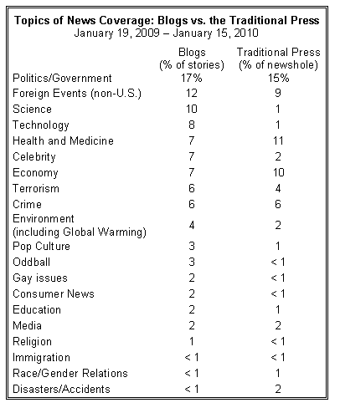

Slide 44
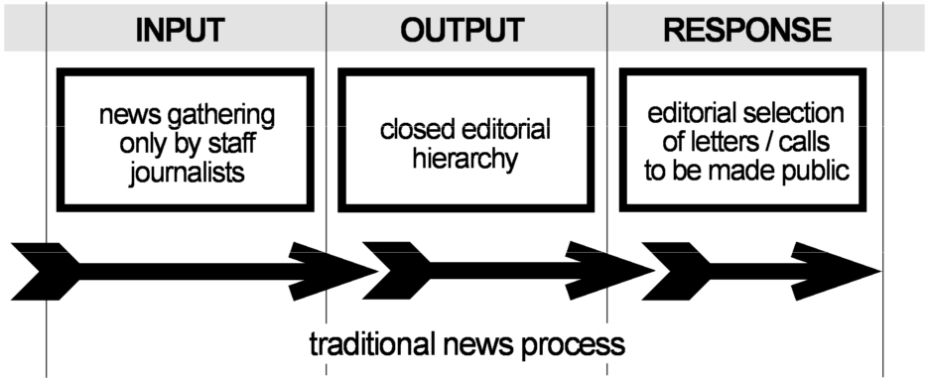
Empowerment: An Optimistic View
2. Gatekeeping → Gatewatching
Gatekeeping: media used to decide what the public needs to know
Media scarcity no longer exists
媒体稀缺性不复存在
Journalists’ judgment can (and does) fail
记者的判断力可能（也确实）会失效
Citizens want to be active and involved
Outdated

Slide 45
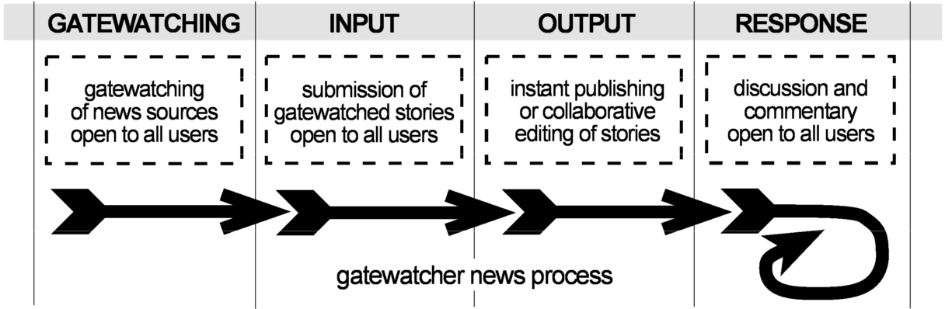
Empowerment: An Optimistic View
2. Gatekeeping → Gatewatching
Gatekeeping: media decide what the public needs to know
Gatewatching: A more organic model of news production that is less controlled by media institutions. Reflected in citizen journalism.

Slide 46
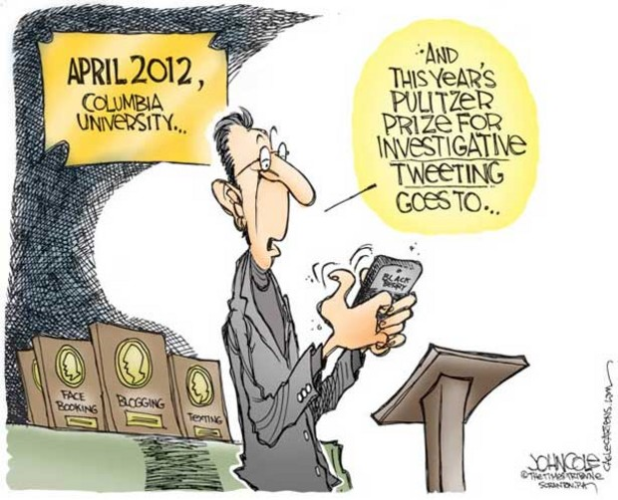
Empowerment: An Optimistic View
The participatory nature of Web 2.0 facilitates civic engagement.
New media provide a platform for different voices and these interactions can
directly shape the events.
New media empower
people by involving them
as a part of the news
production process

Slide 47
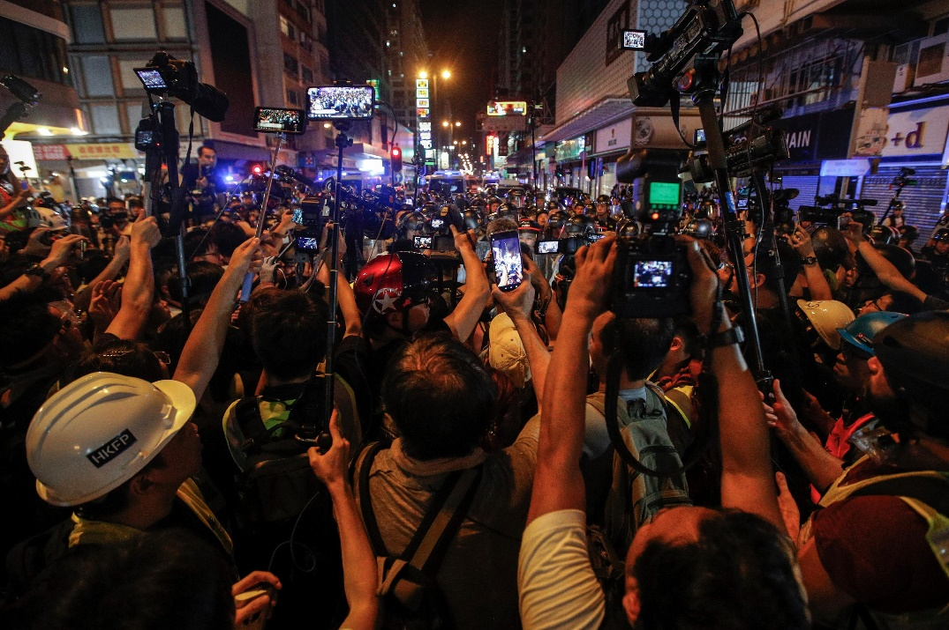
Live-blogging/live-streaming to Drive Conversations
It provides a rolling textual/visual coverage of an ongoing event:
它对一个正在发生的事件提供了滚动的文字/视觉报道。
Sports games
Elections選舉
Ceremonies
Conferences, conventions and gatherings
會議 公約 和集會
Protests and conflicts
Natural events and disasters

Slide 48
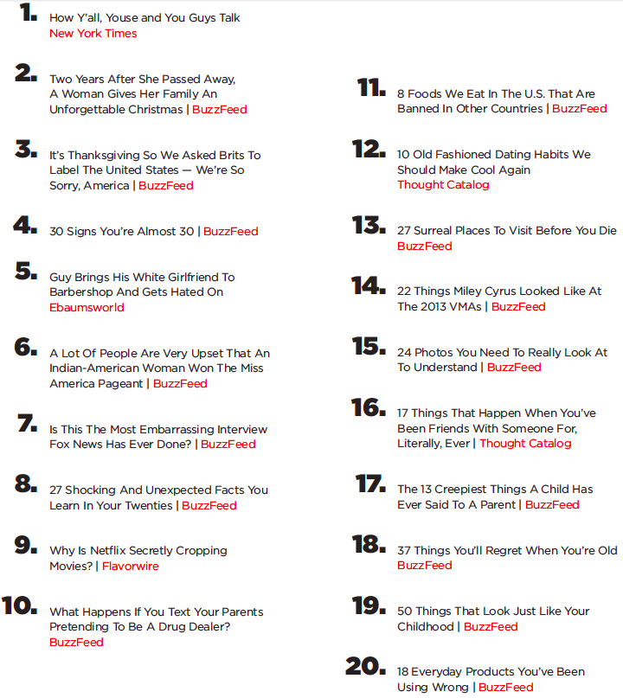
Empowerment: An Optimistic View
BuzzFeed’s top 20 Most Shared Stories
3. Audiences serve as news disseminators（傳播者）
In CJ, the audience is not only a part of the news production
but also plays a role in the
distribution process
Journalists inspire to create stories that capture the readers’ attention on social media to increase shares and unique website visits

Slide 49
But, do new media and citizen journalism really empower citizens?

Slide 50
Empowerment: A Pessimistic View
Jo Tacchi (2010) :
Inclusion and social justice should be the goal of new media
Emphasized the importance of the “universal access to knowledge and information” and the possibility for the “poorest and most marginalized（被邊緣化的）” to get involved in the creation of information exchange

Slide 51

Empowerment: A Pessimistic悲觀的 View

Slide 52
Digital Divide:
The gap that exists between individuals, groups, societies or countries advantaged by the Internet and those relatively disadvantaged by the Internet
Adapted from Everett M. Rogers. (2003). Diffusion of
Innovations, fifth edition, p. 474

Slide 53
The Issue of Digital Divide
Definition: An economic and social inequality in the access to, use of, or impact of information and communication technologies (ICT).
Information and communication technologies:
Fixed or mobile, internet, telephone, digital TV, broadband, etc.
Who does it concern?
Individuals, organizations, enterprises, schools, hospitals, countries, etc.
Usage of ICT
Information retrieval, interactivity, intensive and extensive in usage, innovative contributions, etc.
信息检索、互动性、使用中的密集性和广泛性、创新贡献等。

Slide 54
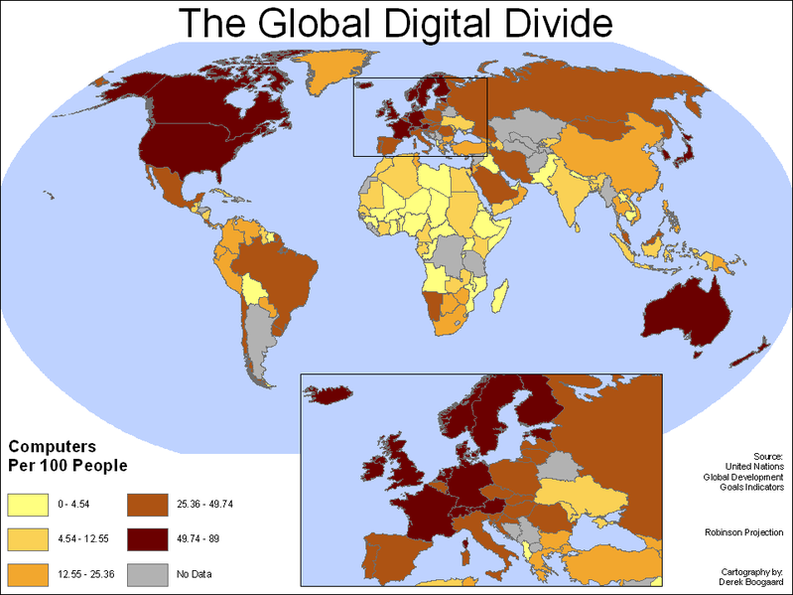
Global Physical Access to Computers

Slide 55
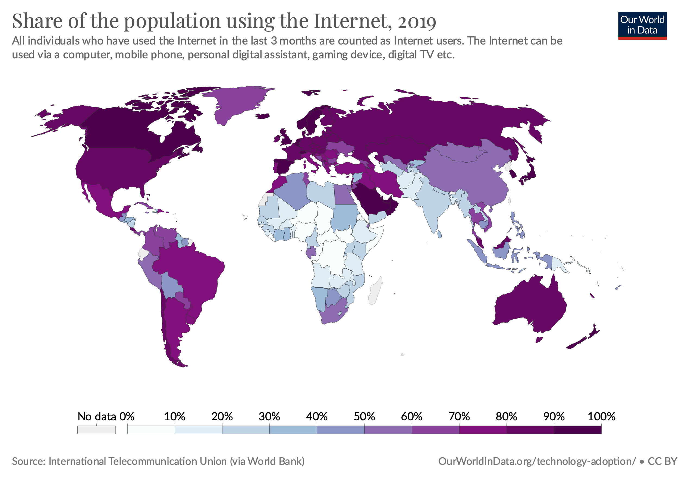

Slide 56
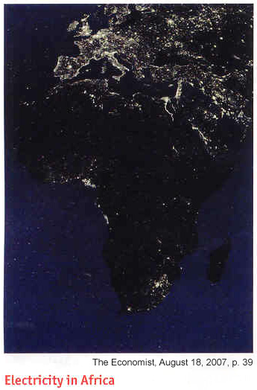
What do you see here?

Slide 57
Power Infrastructure and
The Dark Continent

Slide 58
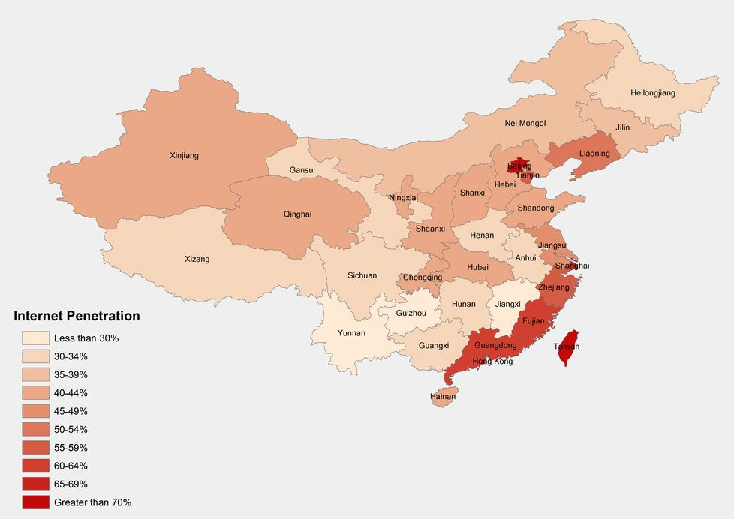
Based on statistics released in 2021 by the China Internet Network Information Center (CNNIC), mainland China has an Internet penetration rate of 71.6%

Slide 59
The Issue of Digital Divide
Digital Divide in Hong Kong (People with less opportunity to use ICT are the socially disadvantaged groups)
People with lower economic status
People with lower education attainment教育程度较低的人
Housewives, esp. those in lower income families
家庭主妇，特别是低收入家庭的主妇
People with disabilities
Homeless people
Source: HK Internet Professional Association

Slide 60
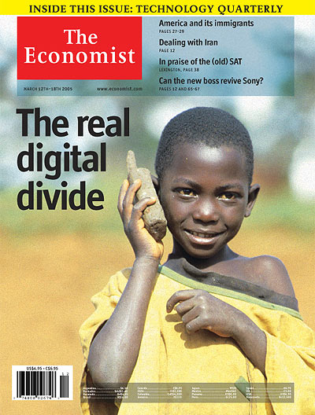
Digital Divide may be caused by:
Infrastructure
Location (space)
Employment status
Income
Education
Race
Age
Sex
(Women with the
same income,
education, and employment level
embrace technology more
than men.)

Slide 61
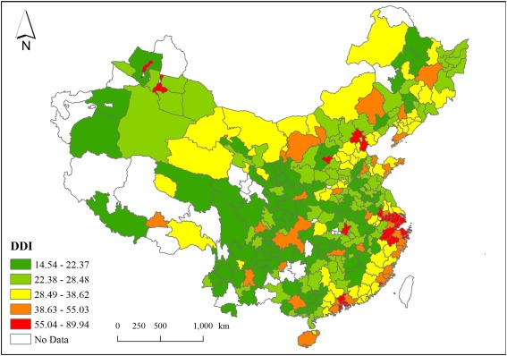
DDI: Digital Divide Index. The higher, the greater the divide.
A large digital divide among the prefectural cities in China was revealed, with cities with a high administrative level having a relatively high digital development index(DDI) score. Prefectural cities with high DDI levels are mainly agglomerated in large metropolitan areas, such as Beijing–Tianjin–Hebei, the Yangtze River Delta, the Pearl River Delta, and the West Coast Economic Zone of the Taiwan Straits.
Notes:
Based on multivariate and spatial analysis

Slide 62
Behind Digital Divide
Digital divide is an outcome of categorical inequalities in the society and it is likely to reinforce the existing inequalities even further
数字鸿沟是社会中分类不平等的结果，它可能会进一步加强现有的不平等。
The Covid-19 virus further exposed the seriousness of China’s digital divide by highlighting the number of students who don’t have access to adequate resources to online learning
Covid-19病毒进一步暴露了中国数字鸿沟的严重性，突出了没有足够资源进行在线学习的学生数量

Slide 63
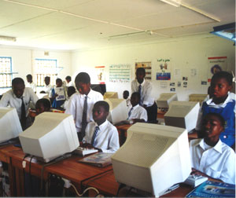

Bridging the digital divide
Increase Physical Access
Many organizations have been formed
Donation of digital device to the victims of the digital divide
Providing residents in rural areas with accessible technology.
为农村地区的居民提供无障碍技术。

Slide 64

One Laptop per Child (OLPC), a non-profit initiative established with the goal of transforming education for children around the world by creating and distributing educational devices for the developing world
每个孩子一台笔记本电脑（OLPC），一个非营利性的倡议，其目标是通过为发展中国家创造和分发教育设备来改变全世界儿童的教育。
Headquarter: Miami, Florida
Established in 2005

Slide 65
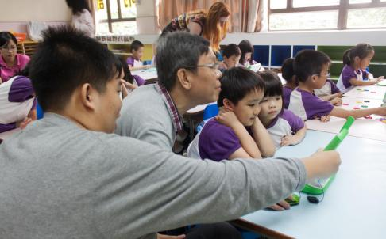
OLPC Comes to Hong Kong
Kelvin Yu (left) and Kang Tsz-kit show Tin Shui Wai kindergarten students how to use the XO laptops. Photos: Alan Wong South China Morning Post, Family Post, September 16, 2012, p. 4

Slide 66
Empowerment:
A third (users’) perspective

Slide 67
Empowerment: A Realistic View
Jönsson & Örnebring (2010)
The authors did a content analysis of the UGC on major newspapers’ websites and tabloids’ in Sweden and the United Kingdom with a focus on (1) degree of participation (low, medium or high), and (2) type of content (information, popular culture/entertainment, private/expressive).

Slide 68
Empowerment: A Realistic View
Jönsson & Örnebring (2010)
“…the concepts of user-generated content and interactivity say little about the character of media audience relations and its democratizing potentials.”
New media do allow for active participation, but that users are mostly empowered to create popular culture-oriented content and personal/everyday life-oriented content rather than news/informational content.
Limited implications for the role of the citizen in the political public sphere.

Slide 69
Empowerment: A Realistic View
Jönsson & Örnebring (2010)
There is not really a shift in power over media content in the mainstream online news media, even if there is a higher degree of participation and interactivity
Empowerment or “Pseudo-power”?
What about Hong Kong?

Slide 70

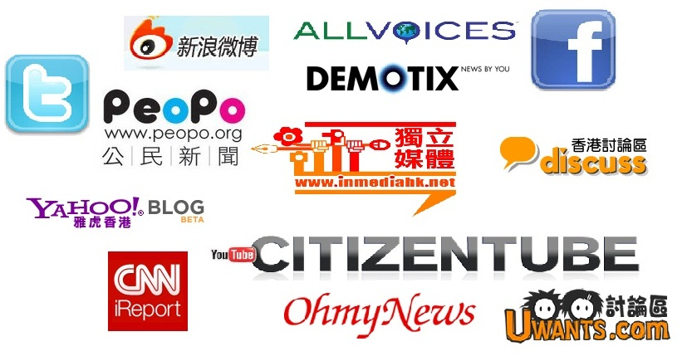
2rd Tweet
Immerse yourself in a citizen media platform of your choice and describe your observation of citizen journalism in one tweet
Hashtag: #CJMedia
Submit URL and screenshot to Canvas
Deadline: Jan 30, 11:55pm

Slide 71
Next Time
Chinese New Year Holiday, No lecture
Watch Tom Rosenstiel’s talk at TEDxAtlanta about the Future of Journalism:
- http://youtu.be/RuBE_dP900Y
Read: Hermida (2012)
Sign up for final project groups on Canvas

